Slide 1

Predicting Wine Quality and Type
https://github.com/garsonbyte/Machine-Learning-Project
Finding the differences between red and white wine
Garson Chow
Mei shin lee

Slide 2
Goals:
DETERMINE WINE QUALITY OF WHITE WINES BASED OFF ELEVEN PREDICTIVE FEATURES
PREDICT WHETHER A WINE SAMPLE IS RED OR WHITE
Find the best algorithm

Slide 3
Methodology
1
Unsupervised Learning:
2
Supervised Learning (Wine Quality):
3
Supervised Learning (Wine Type):
Logistic Regression
Principal Component Analysis
Linear Regression
Support Vector Machine

Slide 4
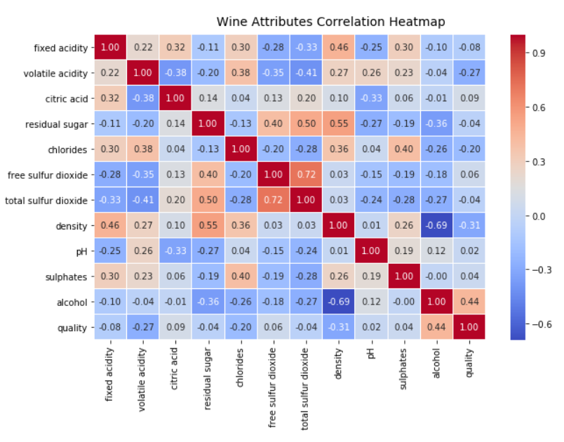
Overview of Data
Wine Type | # of Samples
Red Wine | 1599
White Wine | 4898
Total | 6497
*NOTE THAT WE HAVE ROUGHLY 3 TIMES MORE WHITE WINE SAMPLES THAN RED WINE SAMPLES.

Slide 5
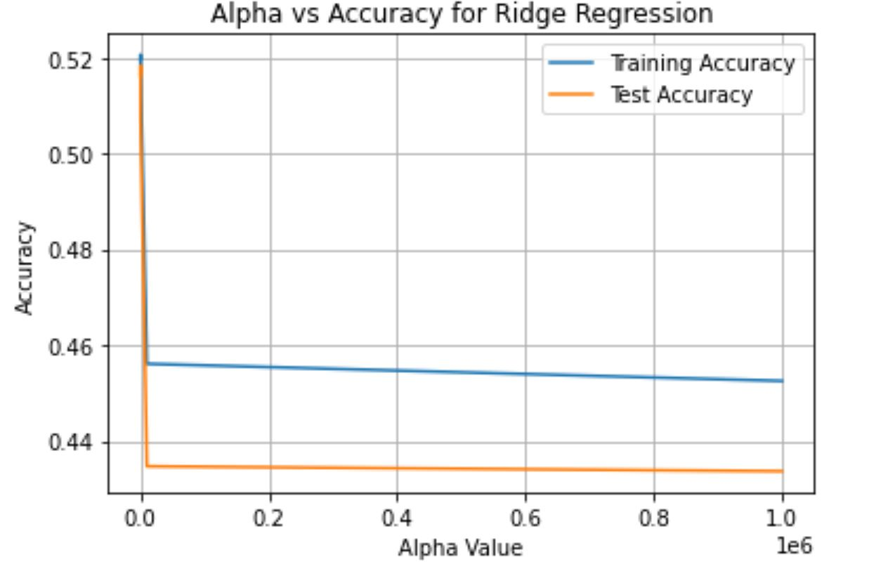

Predicting Wine Quality
PREDICTED WHITE WINE QUALITY USING 11 DIFFERENT FEATURES.
TRAIN/TEST SPLIT RATIO OF 80%:20%
RESULTS:
 | # of Samples
Train | 3918
Test | 980
Total | 4898
WHEN REGULARIZATION WAS ADDED TO OUR MODEL, THE OVERALL ACCURACY RATE DECREASED.
Notes:
We modified the algorithm to round wine quality predictions to the nearest integer. New accuracy of 53%

Slide 6
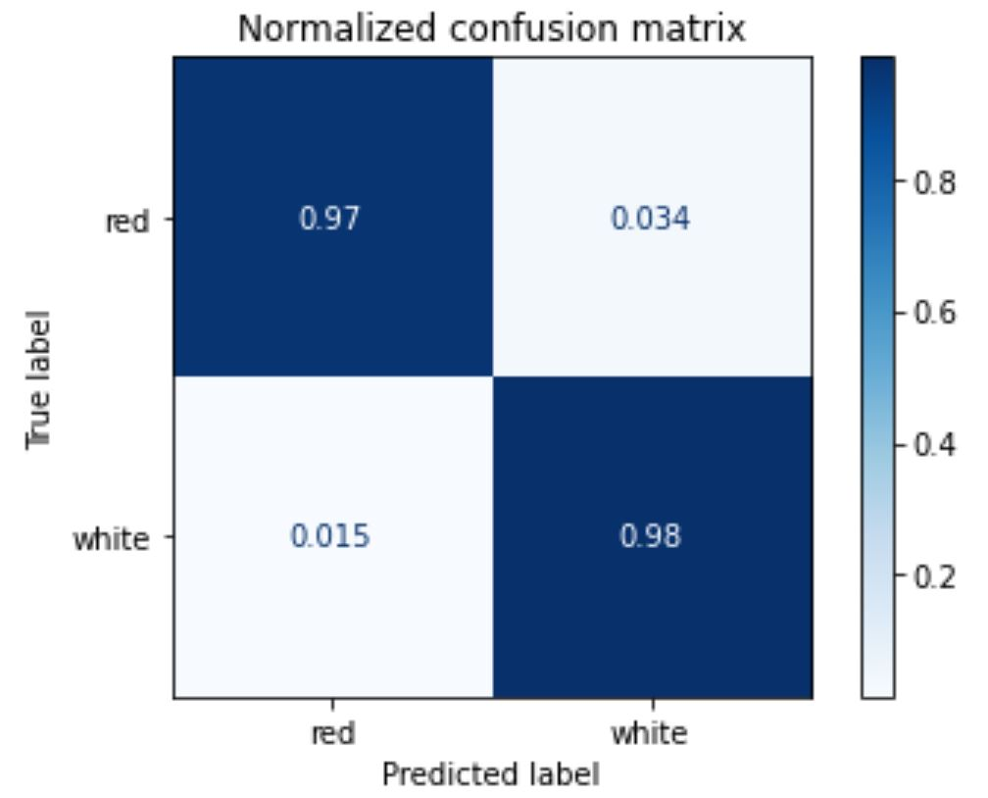
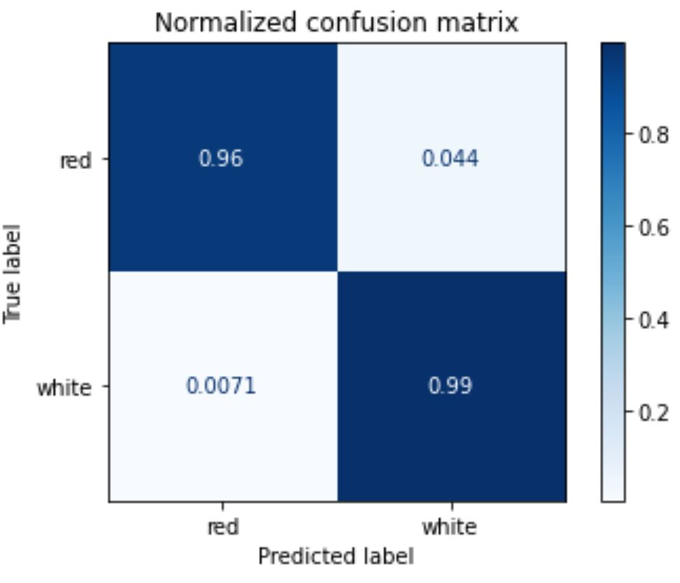
Predicting Wine Type
LOGISTIC REGRESSION
SVM
Notes:
Train test ration 80/20

Slide 7
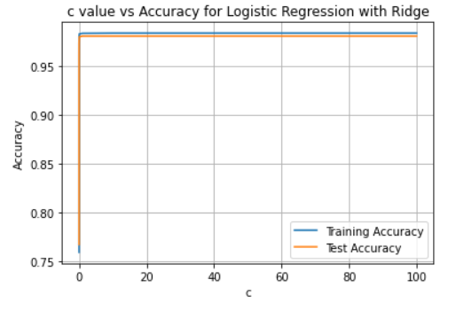
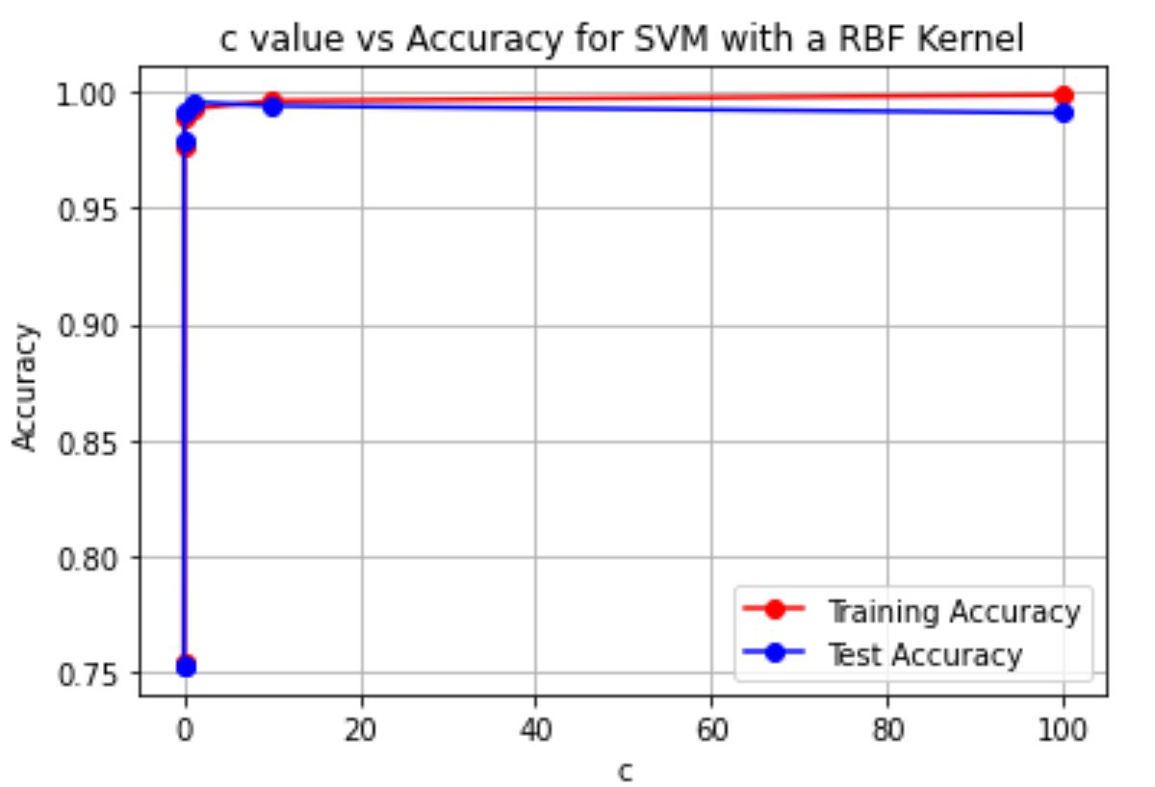
Predicting Wine Type (cont.)
LOGISTIC REGRESSION WITH REGULARIZATION
SVM WITH RBF KERNEL
ADDING REGULARIZATION WORSENED THE PERFORMANCE OF MODEL. THE PIVOT POINT OF THE GRAPH OCCURRED AT C = 1 (DEFAULT VALUE).
ALL KERNELS FOR SVM PRESENTED EQUALLY GOOD RESULTS. AS REGULARIZATION WAS INCREASED, THE ACCURACY OF THE MODEL WAS DECREASED.

Slide 8
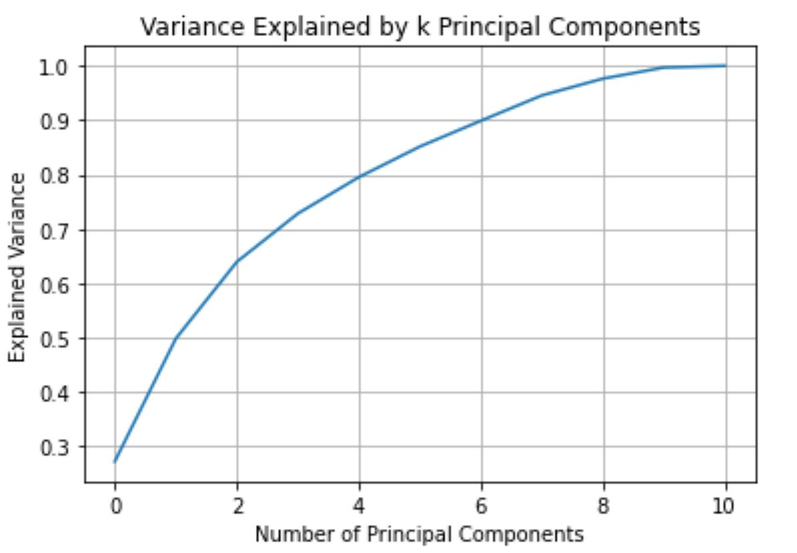
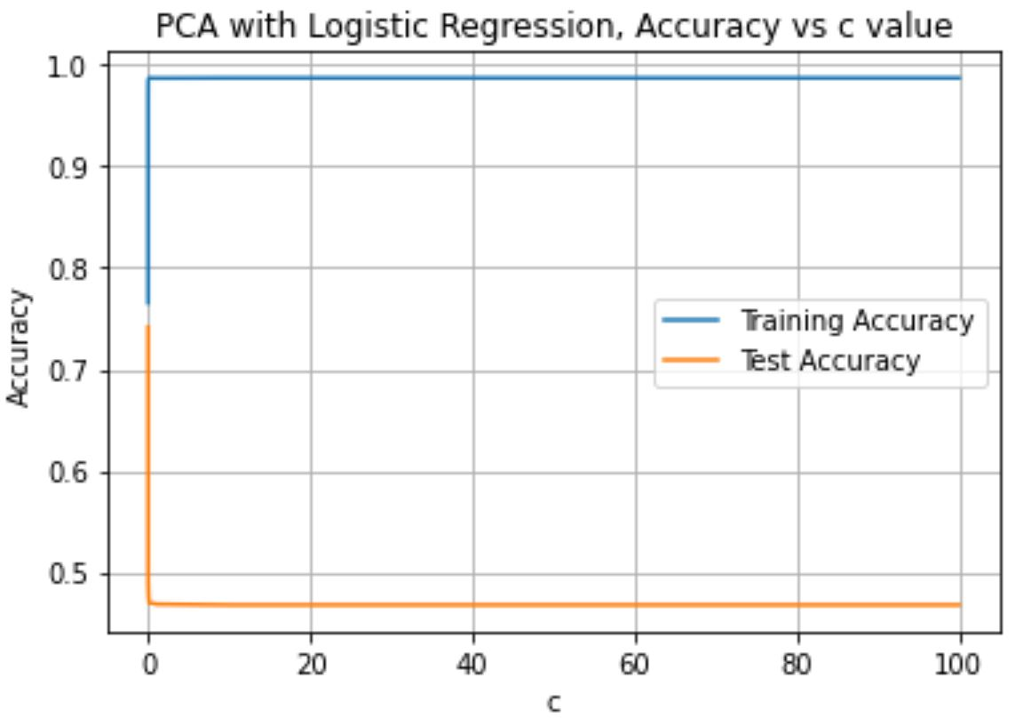
PCA
NO EXPLICIT STRUCTURE WAS FOUND AFTER APPLYING PCA
THE ACCURACY TEST SCORES WERE MUCH LOWER THAN EXPECTED

Slide 9
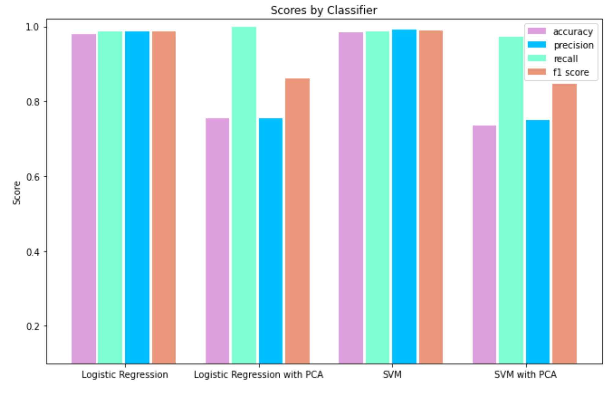
Overall Results for Classification
LOGISTIC REGRESSION AND SVM SHOWED PROMISING RESULTS
APPLYING PCA LOWERED THE ACCURACY AND PRECISION SCORES
98.92 % ACCURACY (SVM)
Notes:
If precision is low = have a lot of false positives
If recall is high = Less false negatives

Slide 10
References
HTTPS://ARCHIVE.ICS.UCI.EDU/ML/DATASETS/WINE+QUALITY
HTTPS://TOWARDSDATASCIENCE.COM/THE-ART-OF-EFFECTIVE-VISUALIZATION-OF-MULTI-DIMENSIONAL-DATA-6C7202990C57#:~:TEXT=THE%20BEST%20WAY%20TO%20GO,A%20DIMENSION%20IN%20THE%20DATA

